Slide 1
Lesson 19 - The Last Week Of Jesus’ Life (1)
Triumphant Entry Into Jerusalem
Matthew 21:1-11, 14-17; Mark 11:1-11;
Luke 19:29-44; John 12:12-19
May 25, 2022

Slide 2
The Journey To Jerusalem
Came From Galilee.
Samaritans refused Jesus. Luke 9:51ff
  Jesus healed a Samaritan. Luke 17:11-13
Came to Jericho.
  Healed two blind men. Matthew 20:29-34;
  Mark 10:46-52; Luke 18:35
  Visited with Zacchaeus. Luke 19:10
Came to Bethany.
  Rested on the Sabbath. John 12:1
  Had supper with Martha, Mary and Lazarus.
  John 12:2-8
  Common people heard him. John 12:9
  Chief Priest desire to kill Lazarus. John 12:10-11;
  cf. John 11:56-57

Slide 3
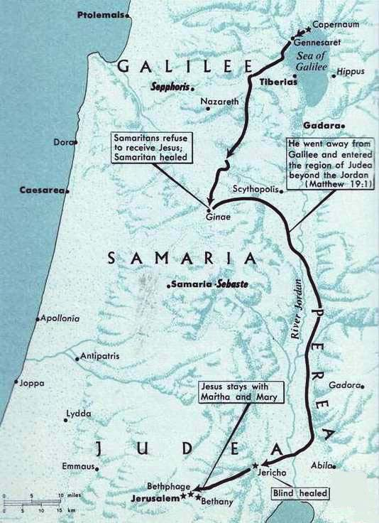
The Journey To Jerusalem
Crossed into the region beyond Jordan. Matthew 19:1
Samaritans refuse to receive Jesus.
Matthew 19:1
Samaritan Healed. Luke 17:11
Stopped in Bethany.
Rested on the Sabbath day.
John 12:1
Healed two blind men, visited Zacchaeus.
Luke 18:35-19:10
About 1,200 feet below sea level.

Slide 4
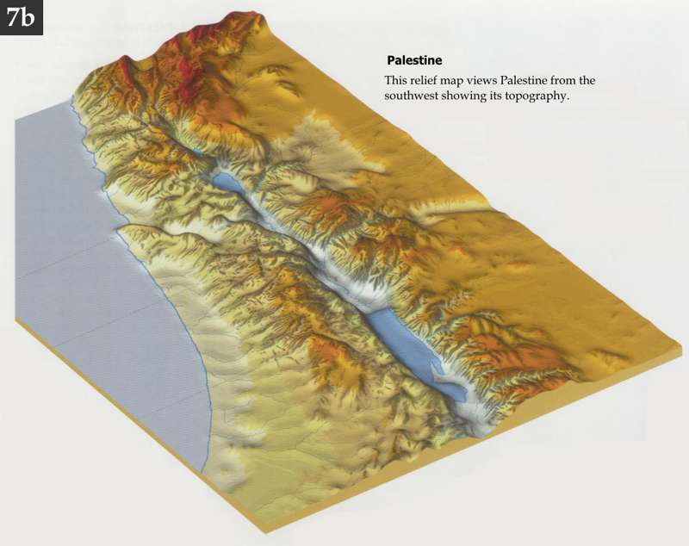
Sea
Of
Galilee
Jericho. About 1,200 feet below sea level.
Jerusalem. About 2,580 feet above sea level.
Jordan River
Surface of the Dead Sea 1,410.8 feet below sea level.
3,780 Feet
rise in elevation from Jericho to Jerusalem.
Mediterranean Sea
Dead
Sea

Slide 5
The Journey To Jerusalem
Sunday
Jesus resumes His journey to Jerusalem. John 12:12

Slide 6
Triumphant Entry Into Jerusalem
Sunday
Preparation:
Secures the colt. Matthew 21:1-7; cf. Mark 11:2;
Luke 19:30
  Fulfilled two Old Testament prophecies.
  Isaiah 62:11, “Behold, Jehovah hath proclaimed unto the end of the earth, Say ye to the daughter of Zion, Behold, thy salvation cometh; behold, his reward is with him, and his recompense before him.”
  Zechariah 9:9, “Rejoice greatly, O daughter of Zion; shout, O daughter of Jerusalem: behold, thy king cometh unto thee; he is just, and having salvation; lowly, and riding upon an ass, even upon a colt the foal of an ass.”

Slide 7
Triumphant Entry Into Jerusalem
Sunday
The Procession Into The City.
Multitude met him with palm branches.
John 12:12-13
Multitude spread their garments on the road.
Matthew 21:8

Slide 8
Triumphant Entry Into Jerusalem
Sunday
Shouts Of The People As Jesus Entered.
Matthew 21:8-9, “And the most part of the multitude spread their garments in the way; and others cut branches from the trees, and spread them in the way. And the multitudes that went before him, and that followed, cried, saying, Hosanna to the son of David: Blessed (is) he that cometh in the name of the Lord; Hosanna in the highest.”
Mark 11:9-10, “And they that went before, and they that followed, cried, Hosanna; Blessed (is) he that cometh in the name of the Lord: Blessed (is) the kingdom that cometh, (the kingdom) of our father David: Hosanna in the highest.”

Slide 9
Triumphant Entry Into Jerusalem
Sunday
Shouts Of The People As Jesus Entered.
Luke 19:37-38, “the whole multitude of the disciples began to rejoice and praise God with a loud voice for all the mighty works which they had seen; saying, Blessed (is) the King that cometh in the name of the Lord: peace in heaven, and glory in the highest.”
John 12:13, “took the branches of the palm trees, and went forth to meet him, and cried out, Hosanna: Blessed (is) he that cometh in the name of the Lord, even the King of Israel.”
Hosanna in Hebrew means “save we pray.”
cf. Psalms 118:25

Slide 10
Triumphant Entry Into Jerusalem
Sunday
Shouts Of The People As Jesus Entered Reflect Misunderstanding Of The Nature Of The Kingdom.
Earlier some had tried to force Jesus to become a king, but He refused. John 6:15
My kingdom is not of this world.
  To the Pharisees. Luke 17:20-21
  To Pilate. John 18:36
  Paul made it clear that the kingdom was spiritual, not physical. Romans 14:17; 1 Corinthians 15:50

